Slide 1

Método de Gauss
VConce

Slide 2
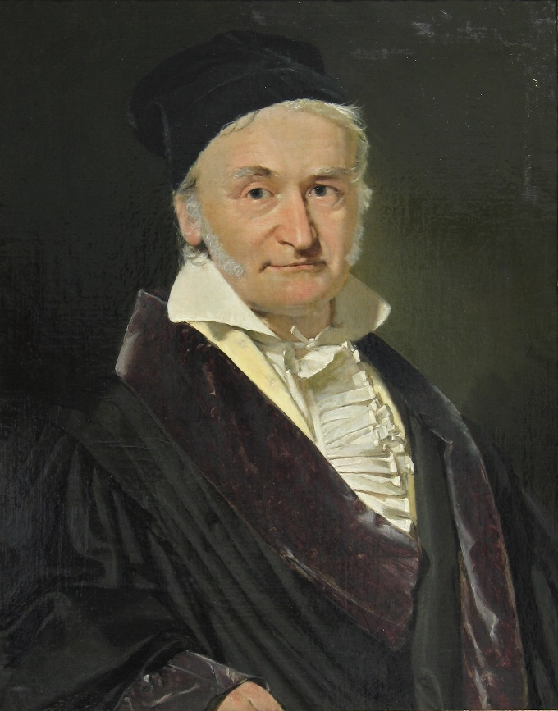

Gauss

Slide 3
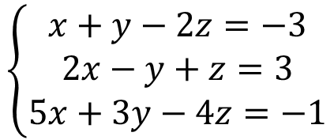
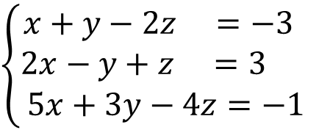
Gauss
$$\left\{\begin{matrix}x+y−2z=−3 \\ 2x−y+z=3 \\ 5x+3y−4z=−1\end{matrix}\right.$$
1
2
$$\left\{\begin{matrix}x+y−2z =−3 \\ 2x−y+z =3 \\ 5x+3y−4z=−1\end{matrix}\right.$$
Método: intentar “escalonar”
el sistema
3

Slide 4
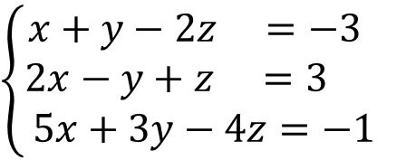
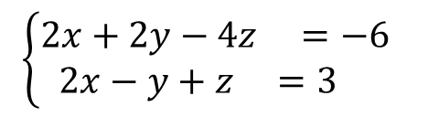
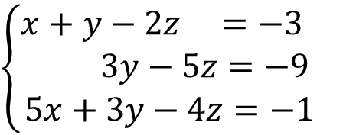


Gauss
Método: intentar “escalonar” el sistema
$$\left\{\begin{matrix}x+y−2z =−3 \\ 2x−y+z =3 \\ 5x+3y−4z=−1\end{matrix}\right.$$
$$\left\{\begin{matrix}2x+2y−4z =−6 \\ 2x−y+z =3 \end{matrix}\right.$$
$$E_{2}→E_{2}−2E_{1}$$
$$3y−5z=−9$$
$$\left\{\begin{matrix}x+y−2z =−3 \\ 3y−5z=−9 \\ 5x+3y−4z=−1\end{matrix}\right.$$

Slide 5
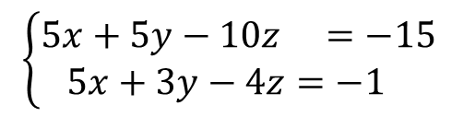
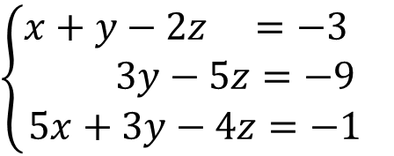

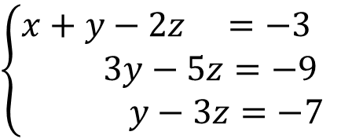


Gauss
Método: intentar “escalonar” el sistema
$$\left\{\begin{matrix}x+y−2z =−3 \\ 3y−5z=−9 \\ 5x+3y−4z=−1\end{matrix}\right.$$
$$\left\{\begin{matrix}5x+5y−10z =−15 \\ 5x+3y−4z=−1 \end{matrix}\right.$$
$$E_{3}→E_{3}−5E_{1}$$
$2y−6z=−$14
$y−3z=−$7
$$\left\{\begin{matrix}x+y−2z =−3 \\ 3y−5z=−9 \\ y−3z=−7\end{matrix}\right.$$

Slide 6
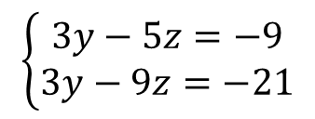
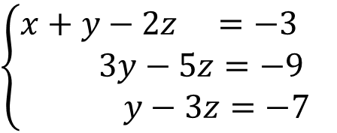

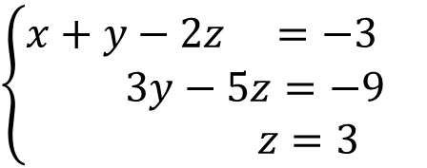


Gauss
Método: intentar “escalonar” el sistema
$$\left\{\begin{matrix}x+y−2z =−3 \\ 3y−5z=−9 \\ y−3z=−7\end{matrix}\right.$$
$$\left\{\begin{matrix}3y−5z=−9 \\ 3y−9z=−21\end{matrix}\right.$$
$$E_{3}→3E_{3}−E_{1}$$
$4z=$12
$$z=3$$
$$\left\{\begin{matrix}x+y−2z =−3 \\ 3y−5z=−9 \\ z=3\end{matrix}\right.$$
Y ahora, arrastra

Slide 7
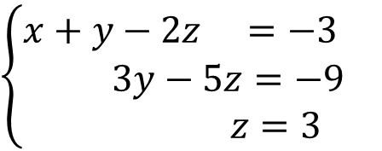
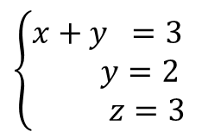
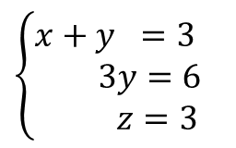
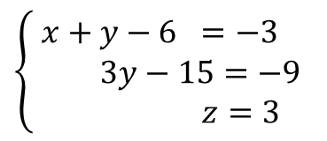
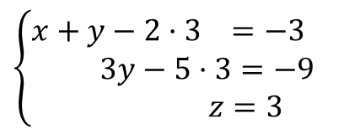
Gauss
Método: intentar “escalonar” el sistema
$$\left\{\begin{matrix}x+y−2z =−3 \\ 3y−5z=−9 \\ z=3\end{matrix}\right.$$
$$\left\{\begin{matrix}x+y−2·3 =−3 \\ 3y−5·3=−9 \\ z=3\end{matrix}\right.$$
$$\left\{\begin{matrix}x+y−6 =−3 \\ 3y−15=−9 \\ z=3\end{matrix}\right.$$
$$\left\{\begin{matrix}x+y =3 \\ 3y=6 \\ z=3\end{matrix}\right.$$
$$\left\{\begin{matrix}x+y =3 \\ y=2 \\ z=3\end{matrix}\right.$$

Slide 8
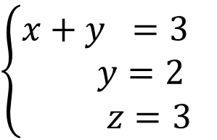
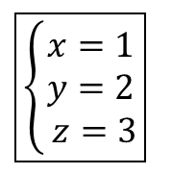
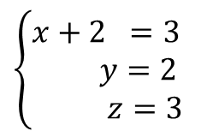
Gauss
Método: intentar “escalonar” el sistema
$$\left\{\begin{matrix}x+y =3 \\ y=2 \\ z=3\end{matrix}\right.$$
$$\left\{\begin{matrix}x+2 =3 \\ y=2 \\ z=3\end{matrix}\right.$$
$$\boxed{\left\{\begin{matrix}x=1 \\ y=2 \\ z=3\end{matrix}\right.}$$

Slide 9
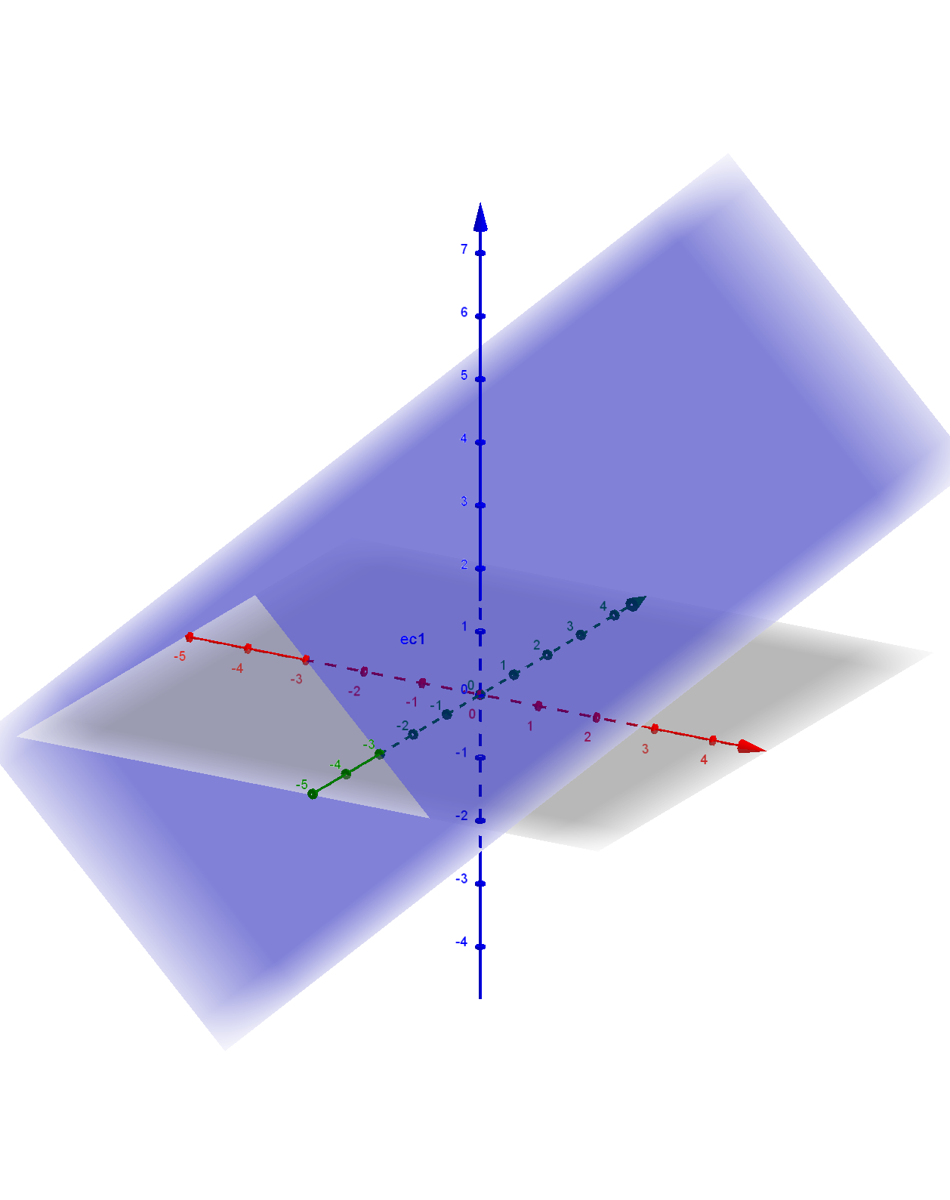
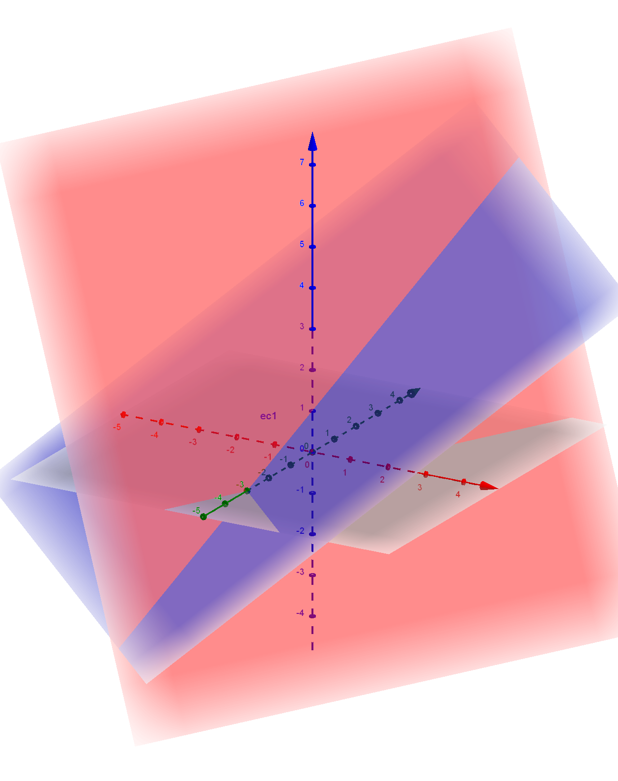
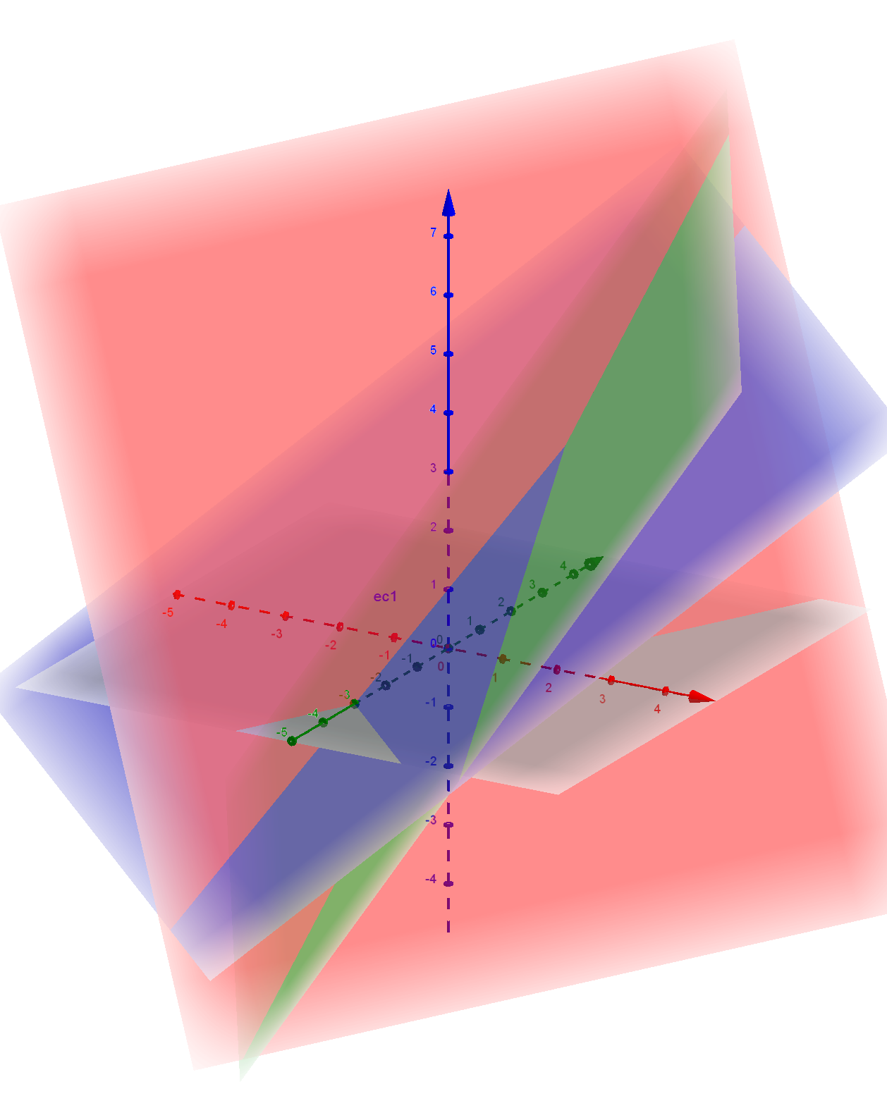
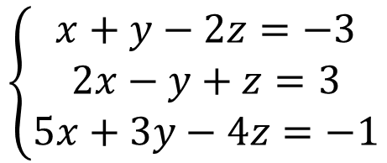
Gauss
Interpretación: cada ecuación LINEAL con tres incógnitas
representa un plano
$$\left\{\begin{matrix}x+y−2z=−3 \\ 2x−y+z=3 \\ 5x+3y−4z=−1\end{matrix}\right.$$
$$\boxed{\left\{\begin{matrix}x=1 \\ y=2 \\ z=3\end{matrix}\right.}$$

Slide 10
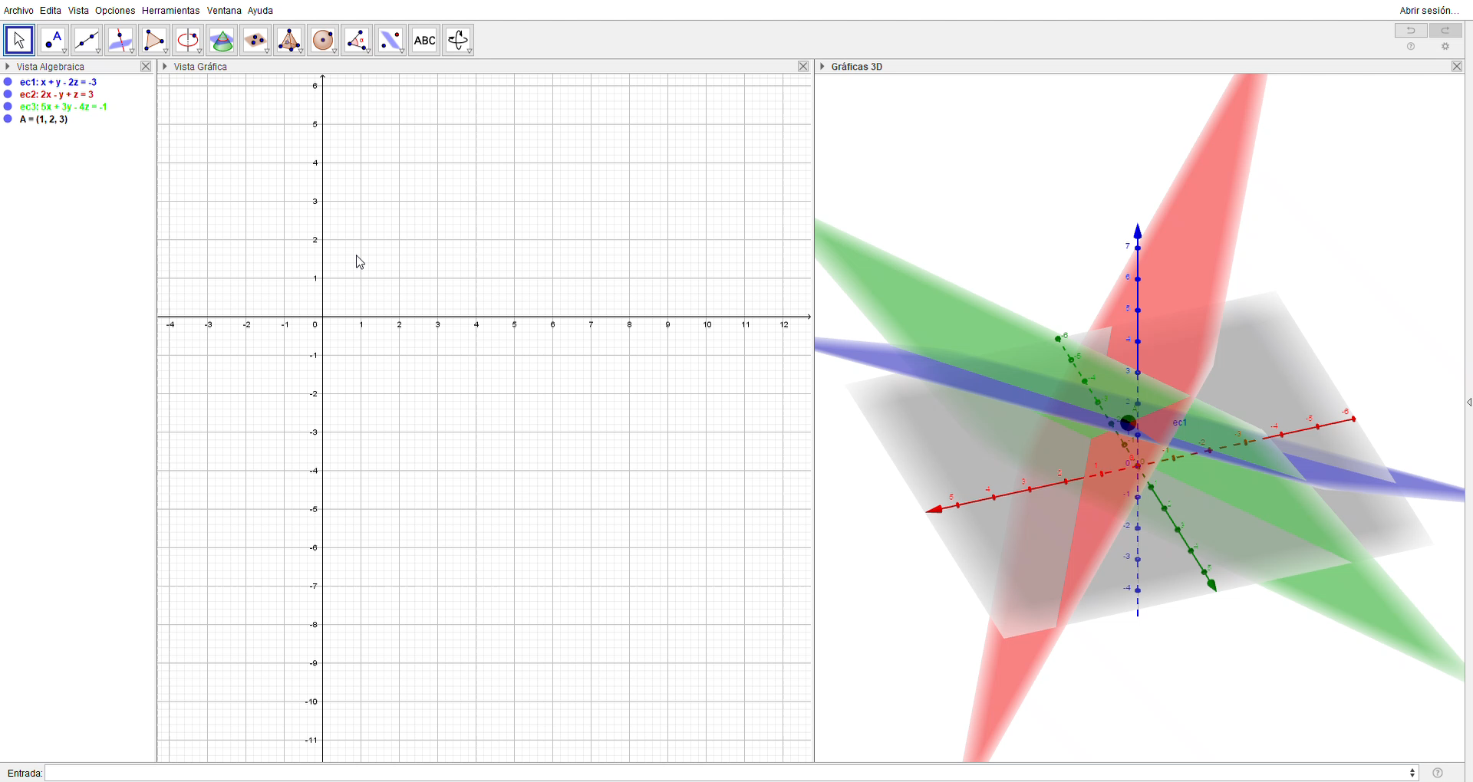
Gauss
Interpretación: cada ecuación LINEAL con tres incógnitas
representa un plano
$$\left\{\begin{matrix}x+y−2z=−3 \\ 2x−y+z=3 \\ 5x+3y−4z=−1\end{matrix}\right.$$
$$\boxed{\left\{\begin{matrix}x=1 \\ y=2 \\ z=3\end{matrix}\right.}$$

Slide 11



Gauss
Prueba tú
Truco 1: cambia las ecuaciones de orden:
$$\left\{\begin{matrix}2x−y+z=2 \\ x−y+z=1 \\ 4x+2y−6z=0\end{matrix}\right.$$
$$\left\{\begin{matrix}x−y+z=1 \\ 2x−y+z=2 \\ 4x+2y−6z=0\end{matrix}\right.$$
Truco 2: simplifica las ecuaciones:
$$E_{3}→\frac{1}{2}E_{3}\left\{\begin{matrix}x−y+z=1 \\ 2x−y+z=2 \\ 2x+y−3z=0\end{matrix}\right.$$

Slide 12
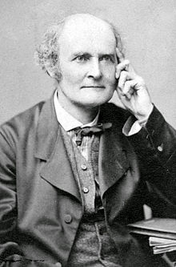
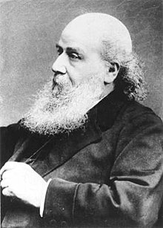

Gauss
Prueba tú
Truco 3: usa matrices:
$$\left\{\begin{matrix}2x−y+z=2 \\ x−y+z=1 \\ 4x+2y−6z=0\end{matrix}\right.$$
$$\left(\begin{matrix}1 & −1 & 1 & 1 \\ 2 & −1 & 1 & 2 \\ 2 & 1 & −3 & 0\end{matrix}\right)$$

Slide 13





Gauss
Prueba tú
$$\left\{\begin{matrix}2x−y+z=2 \\ x−y+z=1 \\ 4x+2y−6z=0\end{matrix}\right.$$
$$\left(\begin{matrix}1 & −1 & 1 & 1 \\ 2 & −1 & 1 & 2 \\ 2 & 1 & −3 & 0\end{matrix}\right)$$
$$\overset{⇒}{\begin{aligned}F_{2}→F_{2}−2F_{1} \\ F_{3}→F_{3}−2F_{1}\end{aligned}}$$
$$\left(\begin{matrix}1 & −1 & 1 & 1 \\ 0 & 1 & −1 & 0 \\ 0 & 3 & −5 & −2\end{matrix}\right)$$
$$\left(\begin{matrix}1 & −1 & 1 & 1 \\ 0 & 1 & −1 & 0 \\ 0 & 0 & −2 & −2\end{matrix}\right)$$
$$\overset{⇒}{F_{3}→F_{3}−3F_{2}}$$

Slide 14





Gauss
Prueba tú
$$\left\{\begin{matrix}2x−y+z=2 \\ x−y+z=1 \\ 4x+2y−6z=0\end{matrix}\right.$$
$$\left(\begin{matrix}1 & −1 & 1 & 1 \\ 0 & 1 & −1 & 0 \\ 0 & 0 & −2 & −2\end{matrix}\right)$$
$$\overset{⇒}{F_{3}→−\frac{1}{2}F_{3}}$$
$$\left(\begin{matrix}1 & −1 & 1 & 1 \\ 0 & 1 & −1 & 0 \\ 0 & 0 & 1 & 1\end{matrix}\right)$$
$$\left(\begin{matrix}1 & −1 & 1 & 1 \\ 0 & 1 & 0 & 1 \\ 0 & 0 & 1 & 1\end{matrix}\right)$$
$$\overset{⇒}{F_{2}→F_{2}+F_{3}}$$

Slide 15




Gauss
Prueba tú
$$\left\{\begin{matrix}2x−y+z=2 \\ x−y+z=1 \\ 4x+2y−6z=0\end{matrix}\right.$$
$$\left(\begin{matrix}1 & −1 & 1 & 1 \\ 0 & 1 & 0 & 1 \\ 0 & 0 & 1 & 1\end{matrix}\right)$$
$$\left(\begin{matrix}1 & 0 & 0 & 1 \\ 0 & 1 & 0 & 1 \\ 0 & 0 & 1 & 1\end{matrix}\right)$$
$$\overset{⇒}{F_{1}→F_{2}+F_{2}−F_{3}}$$
Conclusión:
$$\boxed{\left(\begin{aligned}x \\ y \\ z\end{aligned}\right)=\left(\begin{aligned}1 \\ 1 \\ 1\end{aligned}\right)}$$

Slide 16
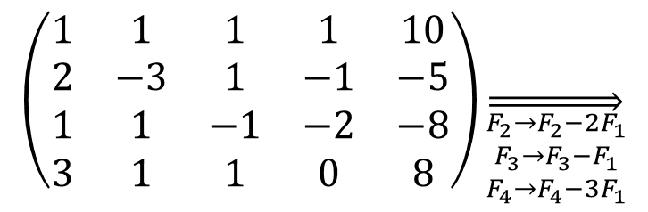

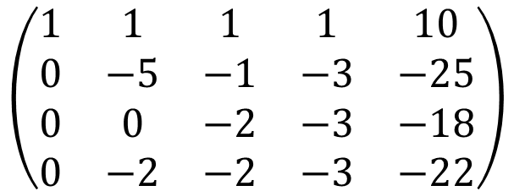
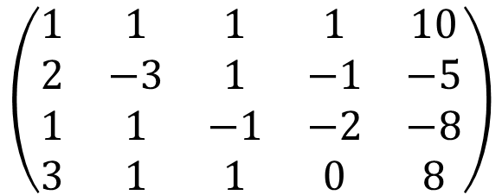
Gauss
Ahora prueba tú:
Truco:
$$\left\{\begin{matrix}x+y+z+t=10 \\ 2x−3y+z−t=−5 \\ x+y−z−2t=−8 \\ 3x+y+z=8\end{matrix}\right.$$
$$\left(\begin{matrix}1 & 1 & 1 & 1 & 10 \\ 2 & −3 & 1 & −1 & −5 \\ 1 & 1 & −1 & −2 & −8 \\ 3 & 1 & 1 & 0 & 8\end{matrix}\right)$$
$$\left(\begin{matrix}1 & 1 & 1 & 1 & 10 \\ 2 & −3 & 1 & −1 & −5 \\ 1 & 1 & −1 & −2 & −8 \\ 3 & 1 & 1 & 0 & 8\end{matrix}\right)\overset{⇒}{\begin{aligned}F_{2}→F_{2}−2F_{1} \\ F_{3}→F_{3}−F_{1} \\ F_{4}→F_{4}−3F_{1}\end{aligned}}$$
$$\left(\begin{matrix}1 & 1 & 1 & 1 & 10 \\ 0 & −5 & −1 & −3 & −25 \\ 0 & 0 & −2 & −3 & −18 \\ 0 & −2 & −2 & −3 & −22\end{matrix}\right)$$

Slide 17
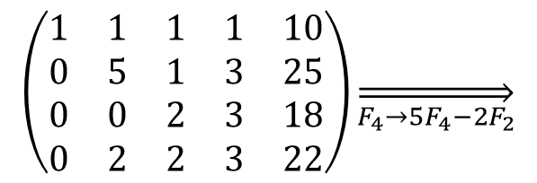
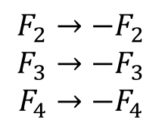
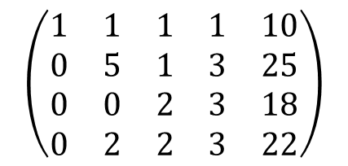

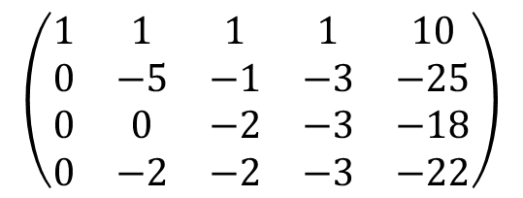
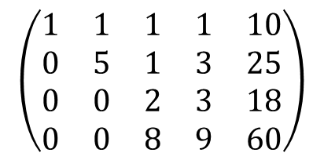
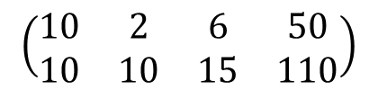
Gauss
Ahora prueba tú:
$$\left(\begin{matrix}1 & 1 & 1 & 1 & 10 \\ 0 & −5 & −1 & −3 & −25 \\ 0 & 0 & −2 & −3 & −18 \\ 0 & −2 & −2 & −3 & −22\end{matrix}\right)$$
$$F_{2}→−F_{2}$$
$$F_{3}→−F_{3}$$
$$F_{4}→−F_{4}$$
$$\left(\begin{matrix}1 & 1 & 1 & 1 & 10 \\ 0 & 5 & 1 & 3 & 25 \\ 0 & 0 & 2 & 3 & 18 \\ 0 & 2 & 2 & 3 & 22\end{matrix}\right)$$
$$\left(\begin{matrix}1 & 1 & 1 & 1 & 10 \\ 0 & 5 & 1 & 3 & 25 \\ 0 & 0 & 2 & 3 & 18 \\ 0 & 2 & 2 & 3 & 22\end{matrix}\right)\overset{⇒}{F_{4}→5F_{4}−2F_{2}}$$
$$\left(\begin{matrix}10 & 2 & 6 & 50 \\ 10 & 10 & 15 & 110\end{matrix}\right)$$
$$\left(\begin{matrix}0 & 8 & 9 & 60\end{matrix}\right)$$
$$\left(\begin{matrix}1 & 1 & 1 & 1 & 10 \\ 0 & 5 & 1 & 3 & 25 \\ 0 & 0 & 2 & 3 & 18 \\ 0 & 0 & 8 & 9 & 60\end{matrix}\right)$$

Slide 18
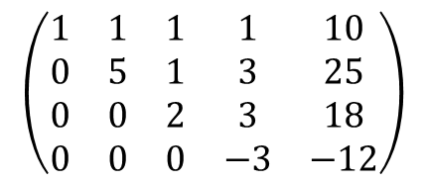
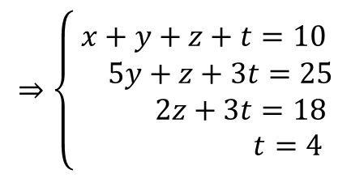
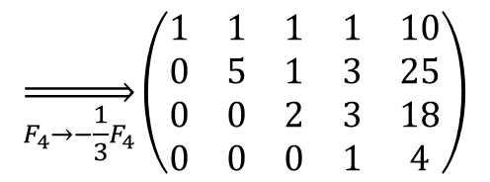
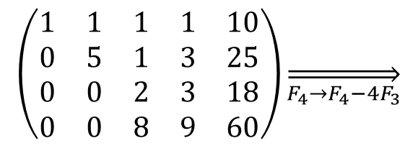
Gauss
Ahora prueba tú:
$$\left(\begin{matrix}1 & 1 & 1 & 1 & 10 \\ 0 & 5 & 1 & 3 & 25 \\ 0 & 0 & 2 & 3 & 18 \\ 0 & 0 & 8 & 9 & 60\end{matrix}\right)\overset{⇒}{F_{4}→F_{4}−4F_{3}}$$
$$\left(\begin{matrix}1 & 1 & 1 & 1 & 10 \\ 0 & 5 & 1 & 3 & 25 \\ 0 & 0 & 2 & 3 & 18 \\ 0 & 0 & 0 & −3 & −12\end{matrix}\right)$$
$$\overset{⇒}{F_{4}→−\frac{1}{3}F_{4}}\left(\begin{matrix}1 & 1 & 1 & 1 & 10 \\ 0 & 5 & 1 & 3 & 25 \\ 0 & 0 & 2 & 3 & 18 \\ 0 & 0 & 0 & 1 & 4\end{matrix}\right)$$
$$⇒\left\{\begin{matrix}x+y+z+t=10 \\ 5y+z+3t=25 \\ 2z+3t=18 \\ t=4\end{matrix}\right.$$

Slide 19
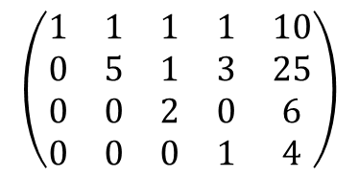
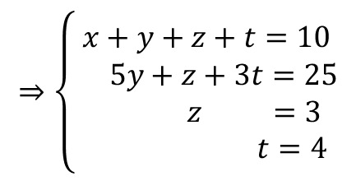
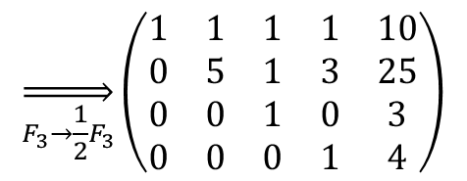
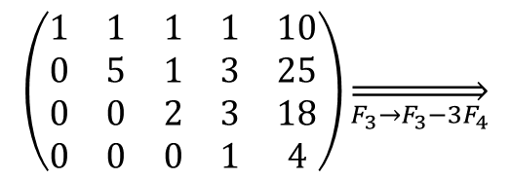
Gauss
Arrastramos:
$$\left(\begin{matrix}1 & 1 & 1 & 1 & 10 \\ 0 & 5 & 1 & 3 & 25 \\ 0 & 0 & 2 & 3 & 18 \\ 0 & 0 & 0 & 1 & 4\end{matrix}\right)\overset{⇒}{F_{3}→F_{3}−3F_{4}}$$
$$\left(\begin{matrix}1 & 1 & 1 & 1 & 10 \\ 0 & 5 & 1 & 3 & 25 \\ 0 & 0 & 2 & 0 & 6 \\ 0 & 0 & 0 & 1 & 4\end{matrix}\right)$$
$$\overset{⇒}{F_{3}→\frac{1}{2}F_{3}}\left(\begin{matrix}1 & 1 & 1 & 1 & 10 \\ 0 & 5 & 1 & 3 & 25 \\ 0 & 0 & 1 & 0 & 3 \\ 0 & 0 & 0 & 1 & 4\end{matrix}\right)$$
$$⇒\left\{\begin{matrix}x+y+z+t=10 \\ 5y+z+3t=25 \\ z =3 \\ t=4\end{matrix}\right.$$

Slide 20
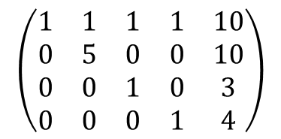
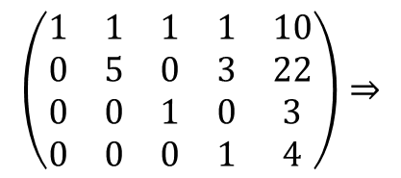
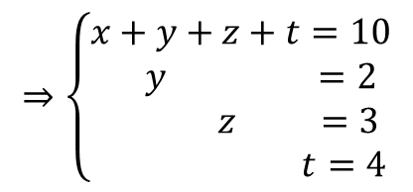
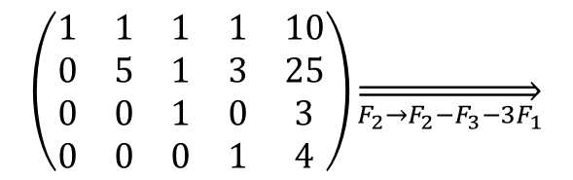
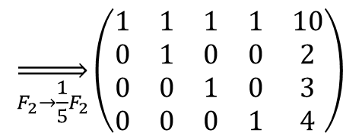
Gauss
Arrastramos:
$$\left(\begin{matrix}1 & 1 & 1 & 1 & 10 \\ 0 & 5 & 1 & 3 & 25 \\ 0 & 0 & 1 & 0 & 3 \\ 0 & 0 & 0 & 1 & 4\end{matrix}\right)\overset{⇒}{F_{2}→F_{2}−F_{3}−3F_{1}}$$
$$\left(\begin{matrix}1 & 1 & 1 & 1 & 10 \\ 0 & 5 & 0 & 3 & 22 \\ 0 & 0 & 1 & 0 & 3 \\ 0 & 0 & 0 & 1 & 4\end{matrix}\right)⇒$$
$$\left(\begin{matrix}1 & 1 & 1 & 1 & 10 \\ 0 & 5 & 0 & 0 & 10 \\ 0 & 0 & 1 & 0 & 3 \\ 0 & 0 & 0 & 1 & 4\end{matrix}\right)$$
$$\overset{⇒}{F_{2}→\frac{1}{5}F_{2}}\left(\begin{matrix}1 & 1 & 1 & 1 & 10 \\ 0 & 1 & 0 & 0 & 2 \\ 0 & 0 & 1 & 0 & 3 \\ 0 & 0 & 0 & 1 & 4\end{matrix}\right)$$
$$⇒\left\{\begin{matrix}x+y+z+t=10 \\ y =2 \\ z =3 \\ t=4\end{matrix}\right.$$

Slide 21



Gauss
Arrastramos:
$$\left(\begin{matrix}1 & 1 & 1 & 1 & 10 \\ 0 & 1 & 0 & 0 & 2 \\ 0 & 0 & 1 & 0 & 3 \\ 0 & 0 & 0 & 1 & 4\end{matrix}\right)\overset{⇒}{F_{1}→F_{1}−F_{2}−F_{3}−F_{4}}$$
$$\left(\begin{matrix}1 & 0 & 0 & 0 & 1 \\ 0 & 1 & 0 & 0 & 2 \\ 0 & 0 & 1 & 0 & 3 \\ 0 & 0 & 0 & 1 & 4\end{matrix}\right)$$
$$⇒\boxed{\left(\begin{aligned}x \\ y \\ z \\ t\end{aligned}\right)=\left(\begin{aligned}1 \\ 2 \\ 3 \\ 4\end{aligned}\right)}$$

Slide 22
Gauss
Toca practicar…

Slide 23






Gauss
Otro tipo de sistemas…
$$\left\{\begin{matrix}x+y−2z =−3 \\ 2x−2y+z =1 \\ 3x−y−z=3\end{matrix}\right.$$
$$\left(\begin{matrix}1 & 1 & −2 & −3 \\ 2 & −2 & 1 & 1 \\ 3 & −1 & −1 & 3\end{matrix}\right)$$
$$\left(\begin{matrix}1 & 1 & −2 & −3 \\ 0 & −4 & 5 & 7 \\ 0 & −4 & 5 & 12\end{matrix}\right)$$
$$\left(\begin{matrix}1 & 1 & −2 & −3 \\ 0 & −4 & 5 & 7 \\ 0 & 0 & 0 & 5\end{matrix}\right)$$
$$\overset{⇒}{\begin{aligned}F_{2}→F_{2}−2F_{1} \\ F_{3}→F_{3}−3F_{1}\end{aligned}}$$
$$\overset{⇒}{F_{3}→F_{3}−F_{2}}$$

Slide 24


Gauss
Otro tipo de sistemas…
$$\left(\begin{matrix}1 & 1 & −2 & −3 \\ 0 & −4 & 5 & 7 \\ 0 & 0 & 0 & 5\end{matrix}\right)⇒$$
$$\left\{\begin{matrix}x+y−2z =−3 \\ −4y+5z=7 \\ 0=5\end{matrix}\right.$$
Sistema incompatible
(no tiene solución)

Slide 25


Gauss
Volvemos al problema original:
Sistema incompatible (no tiene solución)
$$\left\{\begin{matrix}x+y−2z =−3 \\ 2x−2y+z =1 \\ 3x−y−z=3\end{matrix}\right.$$

Slide 26




Gauss
Otro tipo de sistemas…
$$\left\{\begin{matrix}x+y−2z =−3 \\ 2x−2y+z =1 \\ 3x−y−z=−2\end{matrix}\right.$$
$$\left(\begin{matrix}1 & 1 & −2 & −3 \\ 2 & −2 & 1 & 1 \\ 3 & −1 & −1 & −2\end{matrix}\right)$$
$$\overset{⇒}{\begin{aligned}F_{2}→F_{2}−2F_{1} \\ F_{3}→F_{3}−3F_{1}\end{aligned}}\left(\begin{matrix}1 & 1 & −2 & −3 \\ 0 & −4 & 5 & 7 \\ 0 & −4 & 5 & 7\end{matrix}\right)$$
$$\overset{⇒}{F_{3}→F_{3}−F_{2}}\left(\begin{matrix}1 & 1 & −2 & −3 \\ 0 & −4 & 5 & 7 \\ 0 & 0 & 0 & 0\end{matrix}\right)$$

Slide 27







Gauss
Se me ha “ido” una ecuación…
$$\left\{\begin{matrix}x+y−2z =−3 \\ −4y+5z=7 \\ 0=0\end{matrix}\right.$$
$$\left\{\begin{matrix}x+y−2z =−3 \\ −4y+5z=7\end{matrix}\right.$$
Tendré que “inventarme” una de las variables… por ejemplo $z$:
$$\left\{\begin{matrix}x+y−2z =−3 \\ −4y+5λ=7\end{matrix}\right.$$
$$⇒\left\{\begin{matrix}x+y−2z =−3 \\ y=\frac{7−5λ}{−4}\end{matrix}\right.$$
$$z=λ$$
$$⇒\left\{\begin{matrix}x+y−2z =−3 \\ y=−\frac{7}{4}+\frac{5}{4}λ\end{matrix}\right.$$
$$⇒\left\{\begin{matrix}x+−\frac{7}{4}+\frac{5}{4}λ−2λ =−3 \\ y=−\frac{7}{4}+\frac{5}{4}λ\end{matrix}\right.$$

Slide 28


Gauss
Se me ha “ido” una ecuación…
$$\left\{\begin{matrix}x+y−2z =−3 \\ −4y+5z=7 \\ 0=0\end{matrix}\right.$$
Tendré que “inventarme” una de las variables… por ejemplo $z$:
$$\left\{\begin{matrix}x+−\frac{7}{4}+\frac{5}{4}λ−2λ =−3 \\ y=−\frac{7}{4}+\frac{5}{4}λ\end{matrix}\right.$$
$$⇒…⇒\left\{\begin{matrix}x=\frac{3}{4}λ−\frac{5}{4} \\ y=−\frac{7}{4}+\frac{5}{4}λ \\ z=λ\end{matrix}\right.$$

Slide 29


Gauss
Se me ha “ido” una ecuación…
$$⇒\left\{\begin{matrix}x=−\frac{5}{4}+\frac{3}{4}λ \\ y=−\frac{7}{4}+\frac{5}{4}λ \\ z=λ\end{matrix}\right.$$
$$\left\{\begin{matrix}x+y−2z =−3 \\ −4y+5z=7 \\ 0=0\end{matrix}\right.$$
$$P\left(−\frac{5}{4},−\frac{7}{4},0\right) \vec{v}\left(\frac{3}{4},\frac{5}{4},1\right)$$
¿A qué te recuerda esto?

Slide 30



Gauss
Se me ha “ido” una ecuación…
$$⇒\left\{\begin{matrix}x=−\frac{5}{4}+\frac{3}{4}λ \\ y=−\frac{7}{4}+\frac{5}{4}λ \\ z=λ\end{matrix}\right.$$
$$P\left(−\frac{5}{4},−\frac{7}{4},0\right)$$
$$\vec{v}\left(\frac{3}{4},\frac{5}{4},1\right)$$
$$\left\{\begin{matrix}x+y−2z =−3 \\ −4y+5z=7 \\ 0=0\end{matrix}\right.$$
¿A qué te recuerda esto?
Volvamos al sistema original:
$$\left\{\begin{matrix}x+y−2z =−3 \\ 2x−2y+z =1 \\ 3x−y−z=−2\end{matrix}\right.$$

Slide 31
Gauss
A practicar…

